Slide 1






Event-Driven E‑Commerce System
By: Sukhmanpreet Singh (23BAI70426)
Jasmeet Singh (23BAI70651)
AIML Branch, Chandigarh University • Capstone Project (2025)

Slide 2





Introduction:
E-commerce systems demand fast, reliable order processing. Monolithic designs struggle with scale, deployment velocity, and resilience. Event‑driven architecture (EDA) decouples components, enabling asynchronous, real‑time workflows and better fault isolation.
Asynchronous, non‑blocking communication
Loose coupling between services
Improved scalability and failure isolation

Slide 3
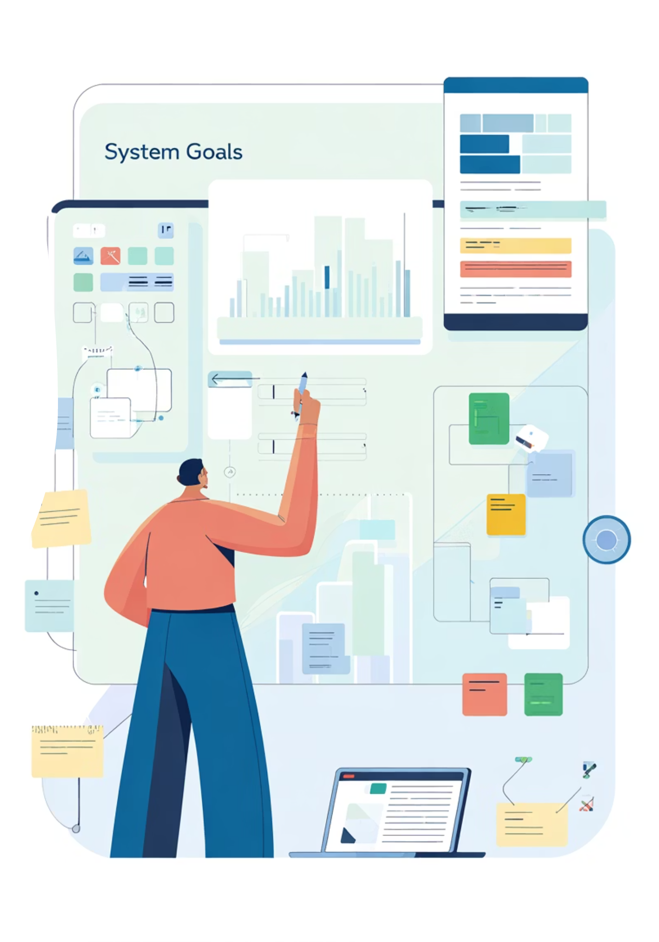
Project Objectives:
1
Microservices:
Implement small, focused Node.js services for order, inventory, payment, and shipping.
2
Event Bus:
Use Kafka as the durable event broker for reliable, ordered message delivery.
3
Real‑time UX:
Provide a React dashboard with WebSocket updates for live order tracking.
4
Asynchronous Flow:
Design event contracts so each microservice reacts and publishes relevant domain events.

Slide 4

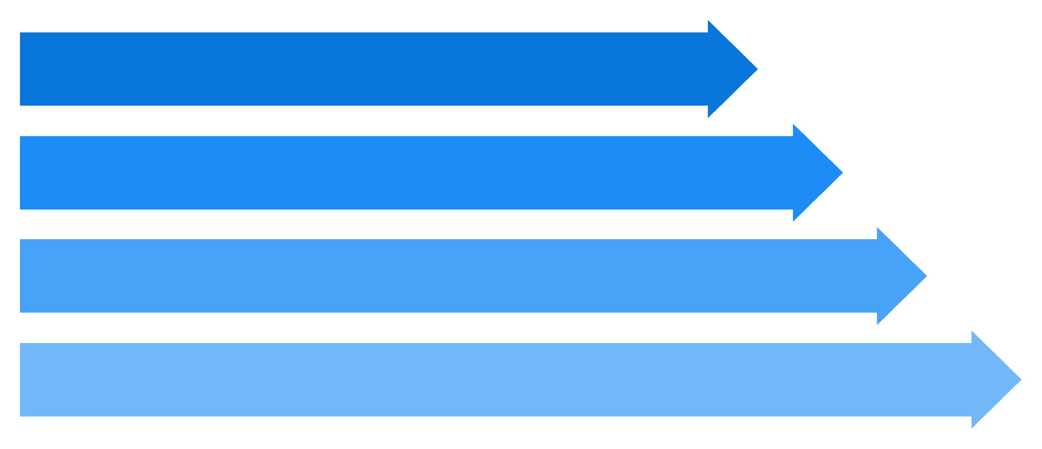



System Architecture (overview):
Single line of progression: Order → Inventory → Payment → Shipping. Kafka provides topics for each domain event; services consume, process, and publish next events. MongoDB serves as the transactional/read store; React + Socket.io powers the dashboard.
Order Created
Inventory Reserved
Payment Authorized
Order Shipped

Slide 5





Technologies:
Backend
Database
Node.js + Express for lightweight services; KafkaJS for broker integration.
MongoDB for event projections and read models (flexible document schema).
Frontend
Tools
React (Vite) with Socket.io-client for low‑latency UI updates.
Docker for local environment, Postman for API testing, VS Code for development.

Slide 6






Workflow: Event Sequence:
Each step below is an independent service reaction to a Kafka topic event. Events are the source of truth for inter-service coordination.
01
1 — Order Created
Order service validates request, persists order draft, publishes OrderCreated.
02
2 — Inventory Reserved
Inventory service reserves stock; on success publishes InventoryReserved or InventoryFailed.
03
3 — Payment Authorized
Payment service attempts authorization; publishes PaymentAuthorized or PaymentFailed.
04
4 — Order Shipped
Shipping service arranges shipment and publishes OrderShipped; triggers final state transition.

Slide 7
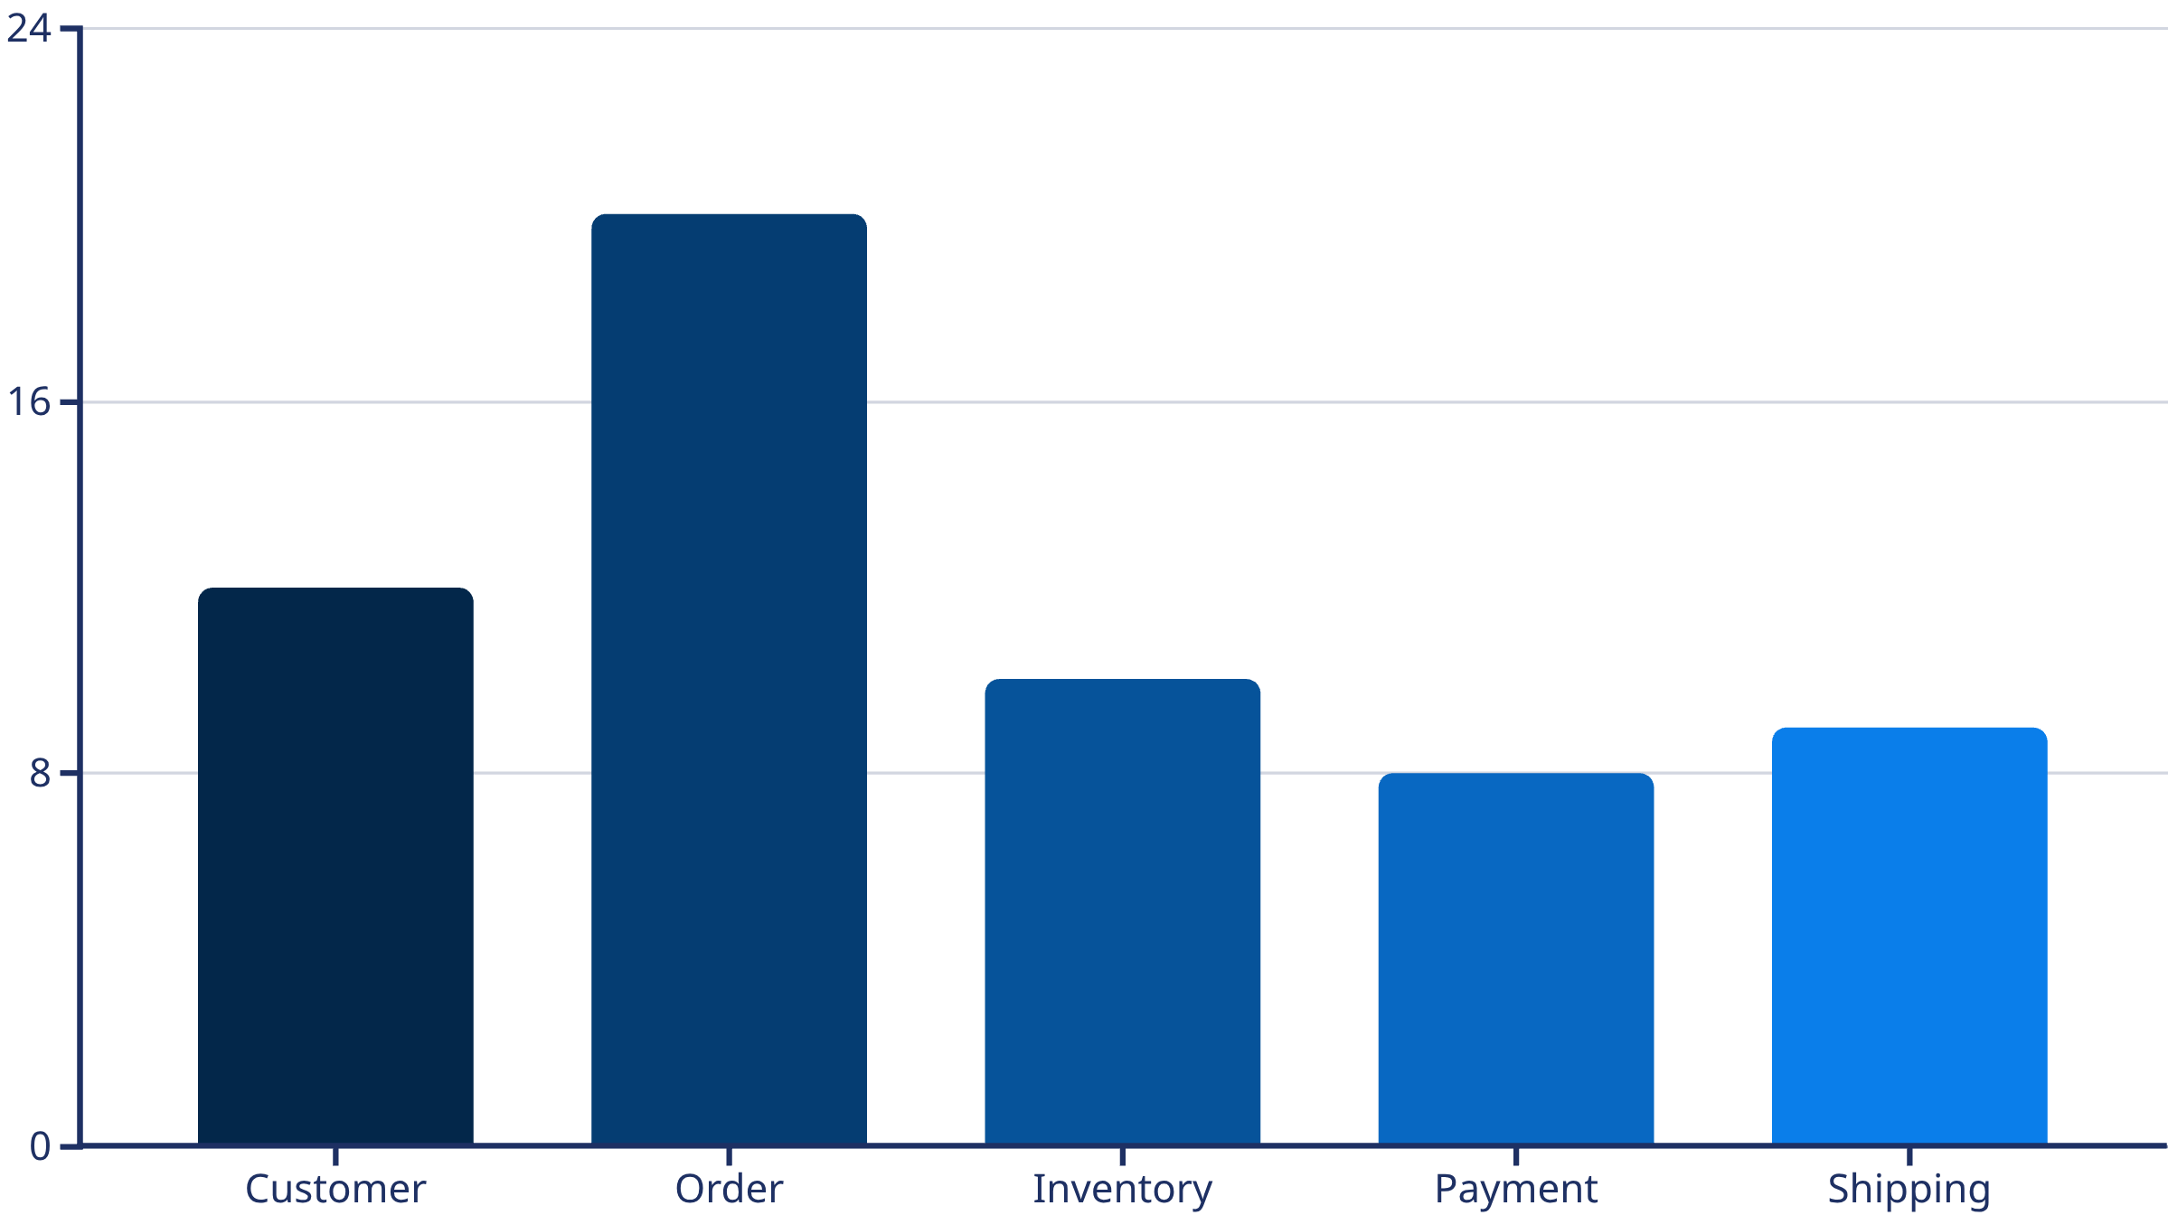

ER Diagram and Domain Model:
Primary entities and key relationships used for persistence and read models.
Relationships: Customer places Order → Order triggers Inventory checks; Order associates with Payment and Shipping records. Use event sourcing patterns for auditability and eventual consistency.

Slide 8
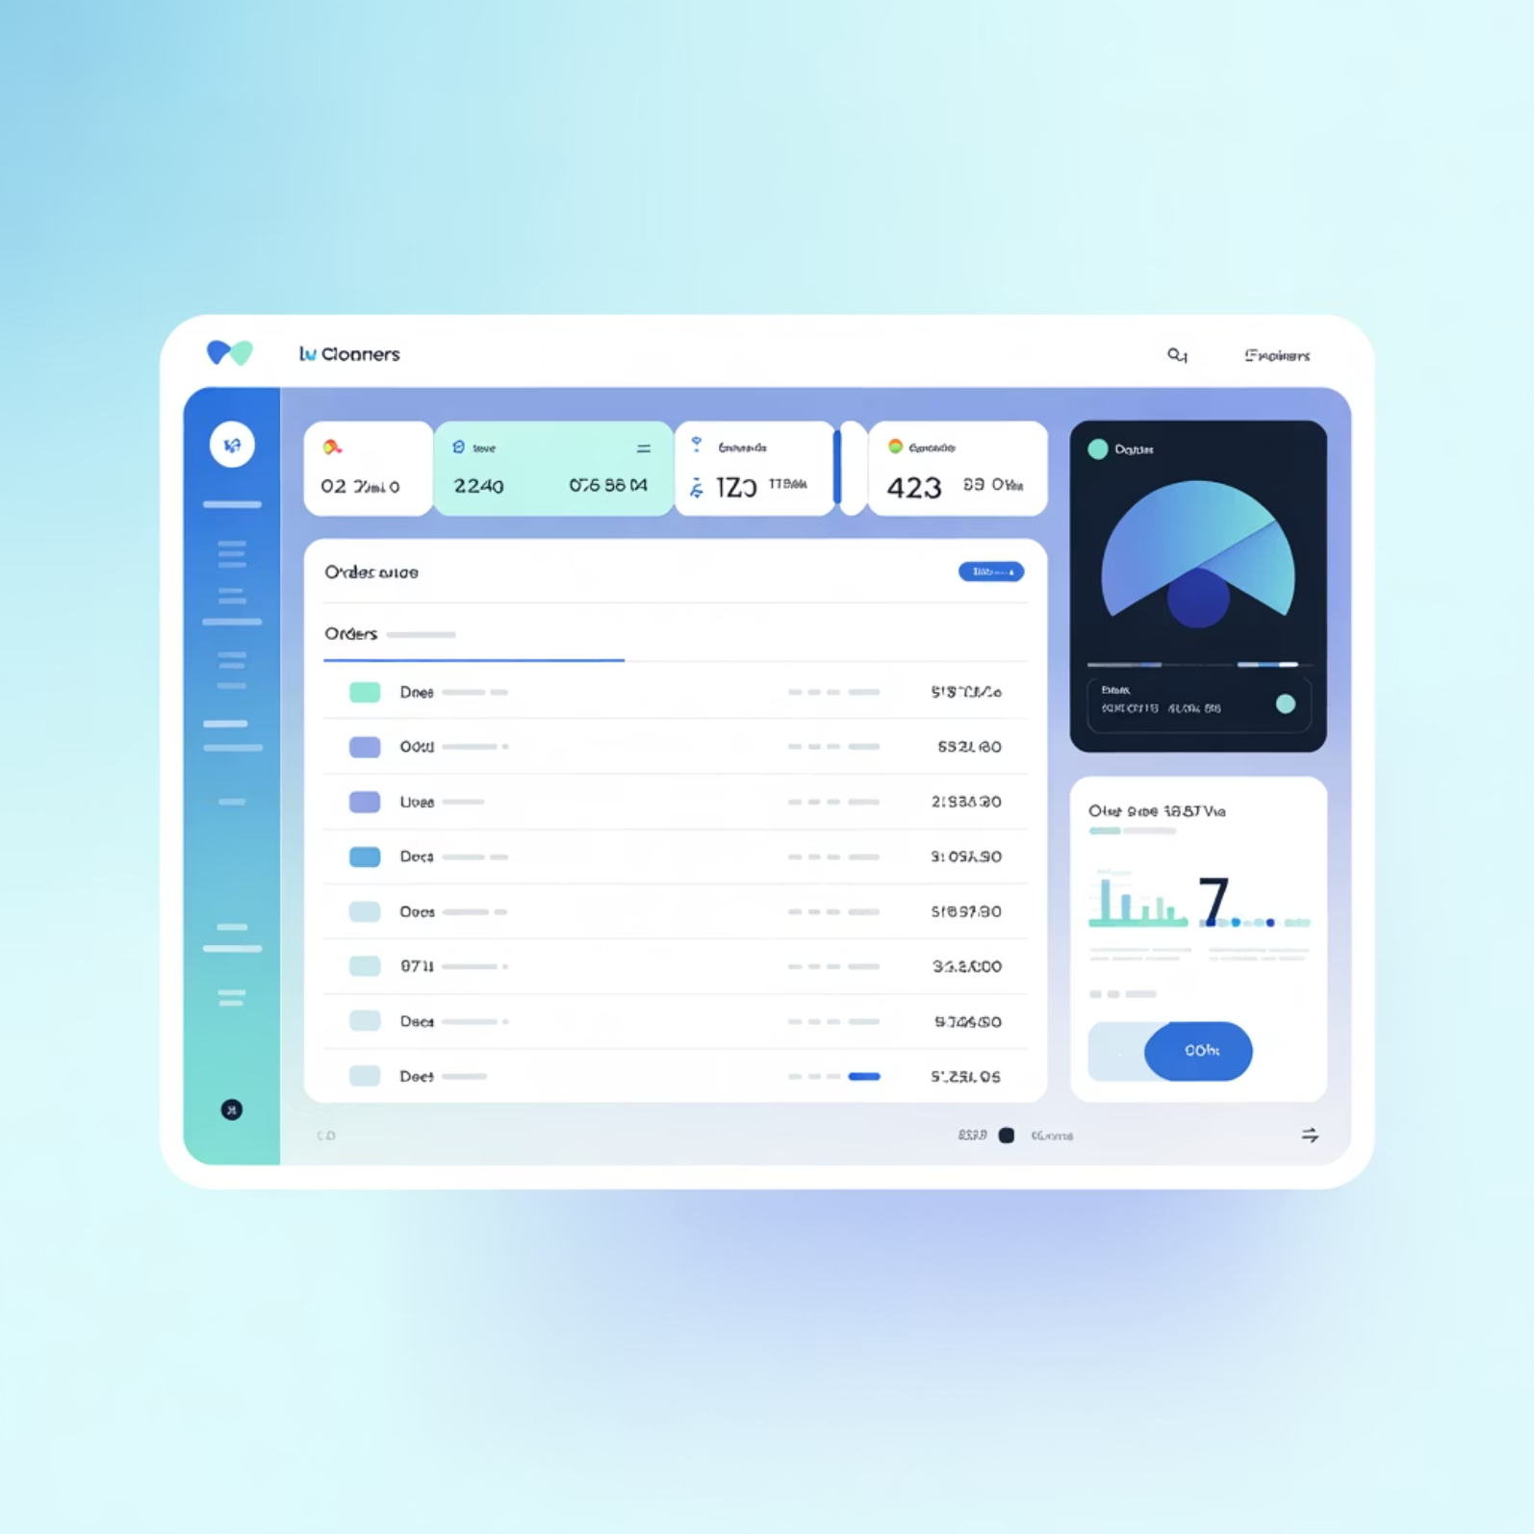

Dashboard Output (UX):
The React dashboard displays a live order table, status timeline, and detailed order view. Read Model Service exposes REST endpoints; WebSocket pushes incremental updates for minimal latency.
Color-coded status indicators (pending, reserved, paid, shipped)
Filter by customer, status, and date range
Per-order event timeline for debugging

Slide 9

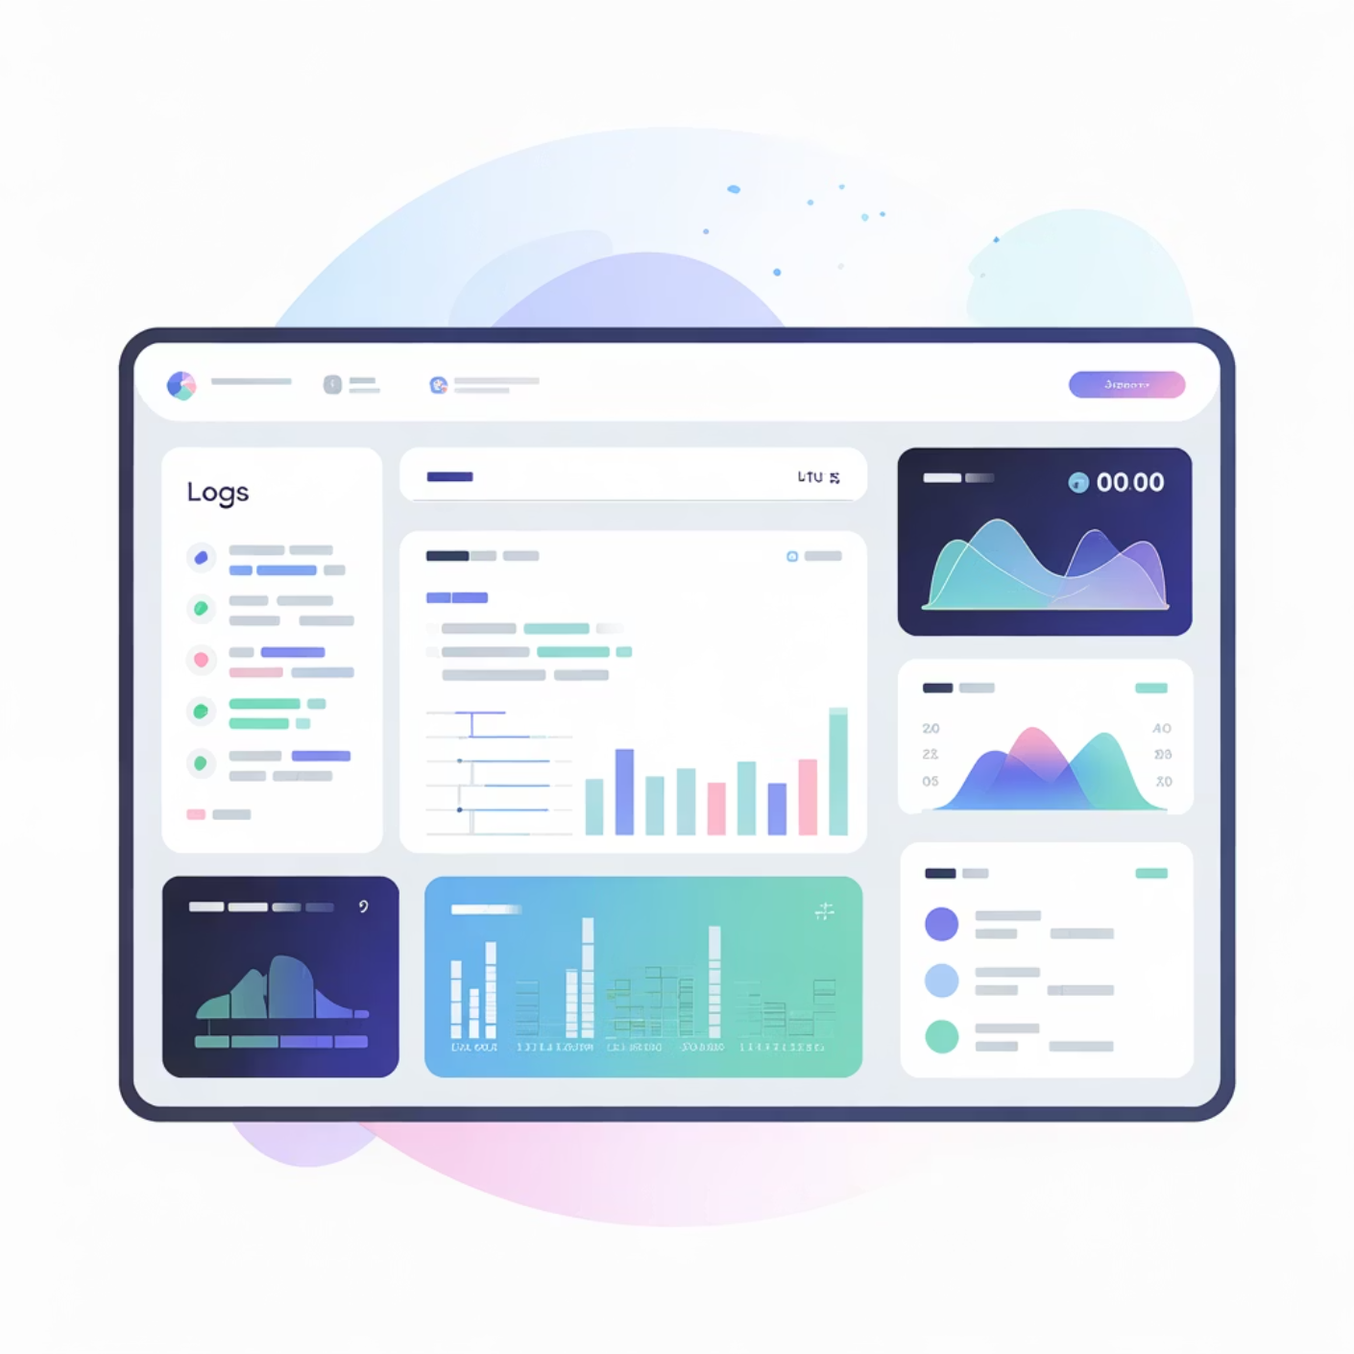
Limitations & Future Scope
Current Limitations
Local deployment only — no cloud infrastructure or HA setup
No production payment gateway or full authentication
Basic error handling and retry logic; needs hardened SRE practices
Future Enhancements
Deploy to AWS/Azure with managed Kafka (MSK/Confluent Cloud) and Kubernetes
Implement JWT/OAuth2 authentication, RBAC, and PCI‑compliant payment integration
Add analytics, observability (tracing, metrics), and automated chaos testing
Repository: github.com/sukhman814/event-driven-ecommerce

Slide 10






